Slide 1

UNIVERSAL MODULAR BOOSTER TRANSFORMER FOR MEDIUM VOLTAGE DISTRIBUTION NETWORKS
The work has been carried out with the financial support of the Ministry of Education and Science of the Russian Federation
(Agreement № 14.577.21.0242 on granting subsidies from 26.09.2017, the unique identifier of the project RFMEFI57717X0242).
Global Invention Forum in Cyprus
October 14-15, 2020

Slide 2




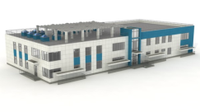
SOLVED PROBLEM
Transition to a Smart Grid system
operational power flows control in medium voltage distribution networks
structure management of medium voltage distribution networks
reduction in the cost of power supply for the end consumer
Universal modular booster transformer (UMBT)
Main power transmission lines
U>110 kV
Operating principle
DDS
110/6-10 kV
Power distribution network
6-10 kV
DDS
110/6-10 kV
UMBT1
6-10 kV
TS
6-10/
0,4 kV
TS
6-10/
0,4 kV
UMBT 2
6-10 kV
Transversal voltage control
(voltage phase change)
Longitudinal voltage control
(voltage value change)
TS
6-10/
0,4 kV
TS
6-10/
0,4 kV
Active power flow change
Reactive power flow change
power flow direction and value change

Slide 3


UNIVERSAL MODULAR BOOSTER TRANSFORMER (UMBT)
6/0.4 kV
6 kV
Electricity consumer
Shunt transformer
Series
transformers
Thyristor
switch
Control system
UMBT
Performed functions
Voltage regulation at distribution network nodes
Regulation of active and reactive power flows
Changing the configuration of the distribution network
Technical characteristics of the UMBT
Parameter | Value
Nominal voltage (supply voltage) | 6 kV ±10%
Variation range of the angle voltage phase α | ± 5°
Measurement resolution of the phase shift voltage α | 1.5°
Range of regulation voltage | ± 10%
Regulation discreteness of the voltage amplitude | ≤ 1.5%
Load power | ≤ 630 кVA
Shunt-wound transformer power | 106 kVA
Series transformer power | 3×28 kVA
Intellectual property
Patent RU 2710886 (30.12.2019)

Slide 4
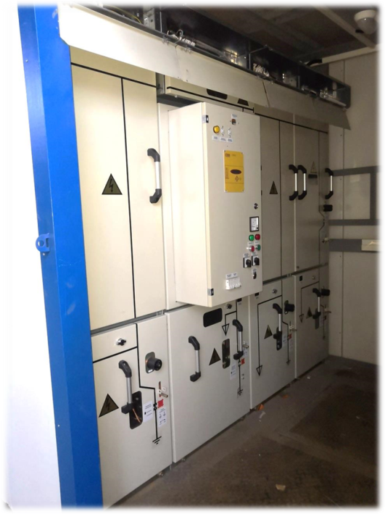
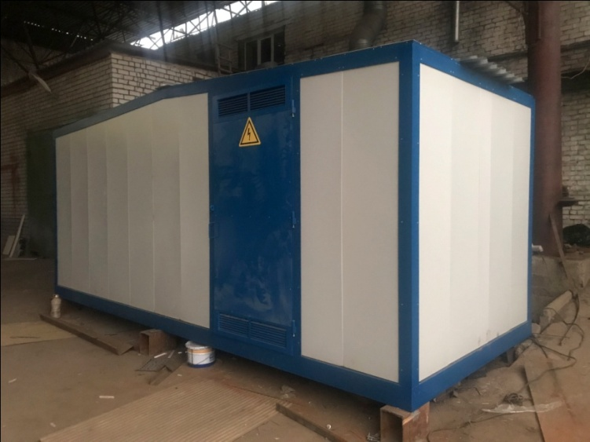
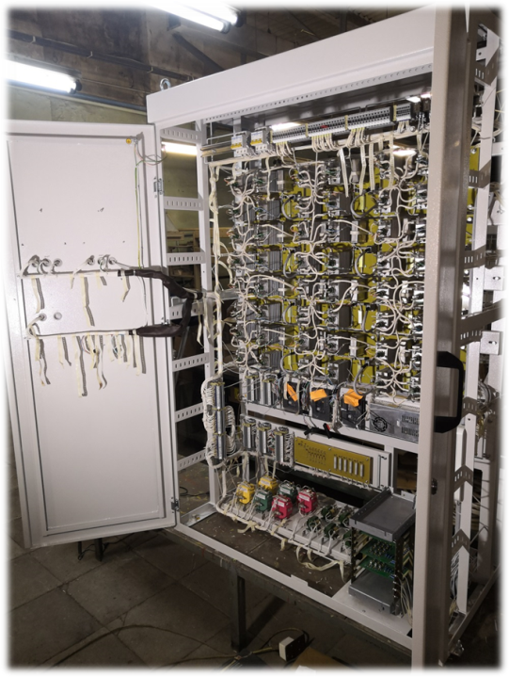
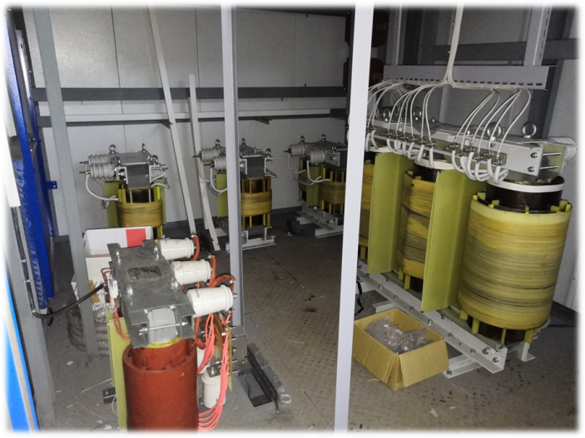
UNIVERSAL MODULAR BOOSTER TRANSFORMER PROTOTYPE
High voltage switchgear
Thyristor
switch
Shunt and series
transformers

Slide 5
POSITIVE IMPACT
Stabilization of voltage level on consumer buses
Reduction of electrical losses in the network
Increasing the capacity of power lines
Load equalization of supply transformers
Improving the reliability of power supply
DDS
110/6-10 kV
TS
6-10/
0,4 kV
Power transmission line
10 kV
Electricity consumer
TVR
6-10 kV
Un+10%
Un
Un-10%
Un-20%
COMPETITIVE ADVANTAGES
COMPETITIVE ADVANTAGES
Connection without reconstruction of electrical networks
High-speed operation
Increased operational life
Electric power complex enterprises
Industrial enterprises with a multi-level internal power supply system

Slide 6
Electric Power Engineering, Power Supply and Power Electronics Department
Project Manager
DSc, professor Elena Sosnina
+79092872290, e-mail: sosnina@nntu.ru

